Slide 1
Chapter 8 Oscillators
8.1 Performance Parameters
8.2 Basic Principles
8.3 Cross-Coupled Oscillator
8.4 Three-Point Oscillators
8.5 Voltage-Controlled Oscillators
8.6 LC VCOs with Wide Tuning Range
8.7 Phase Noise
8.8 Design Procedure
8.9 LO Interface
8.10 Mathematical Model of VCOs
8.11 Quadrature Oscillators
8.12 Appendix A: Simulation of
Quadrature Oscillators
Behzad Razavi, RF Microelectronics.
Prepared by Bo Wen, UCLA

Slide 2
Chapter Outline
General
Principles
Voltage-Controlled
Oscillators
Feedback View
One-Port View
Cross-Coupled Oscillator
Three-Point Oscillators
Tuning Limitations
Effect of Varactor Q
VCOs with Wide Tuning Range
Quadrature
VCOs
Phase Noise
Effect of Phase Noise
Analysis Approach I
Analysis Approach II
Noise of Bias Current
VCO Design Procedure
Low-Noise VCOs
Coupling into an Oscillator
Basic Topology
Properties of Quadrature Oscillators
Improved Topologies

Slide 3
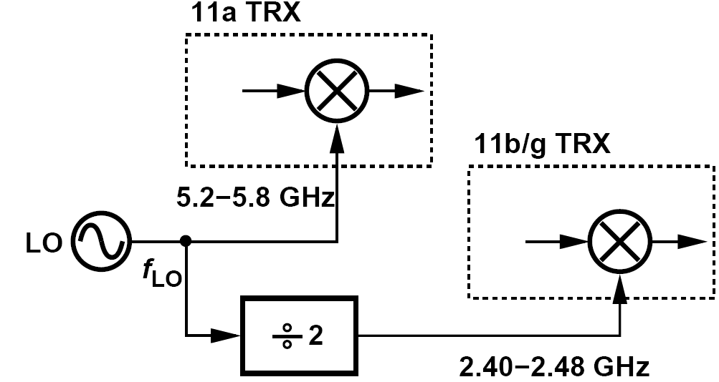
Performance Parameters: Frequency Range
An RF oscillator must be designed such that its frequency can be varied (tuned) across a certain range. This range includes two components:
(1) the system specification;
(2) additional margin to cover process and temperature variations and errors due to modeling inaccuracies.
A direct-conversion transceiver is designed for the 2.4-GHz and 5-GHz wireless bands. If a single LO must cover both bands, what is the minimum acceptable tuning range?
For the lower band, 4.8 GHz ≤ f_{LO} ≤ 4.96 GHz. Thus, we require a total tuning range of 4.8 GHz to 5.8 GHz, about 20%. Such a wide tuning range is relatively difficult to achieve in LC oscillators.

Slide 4
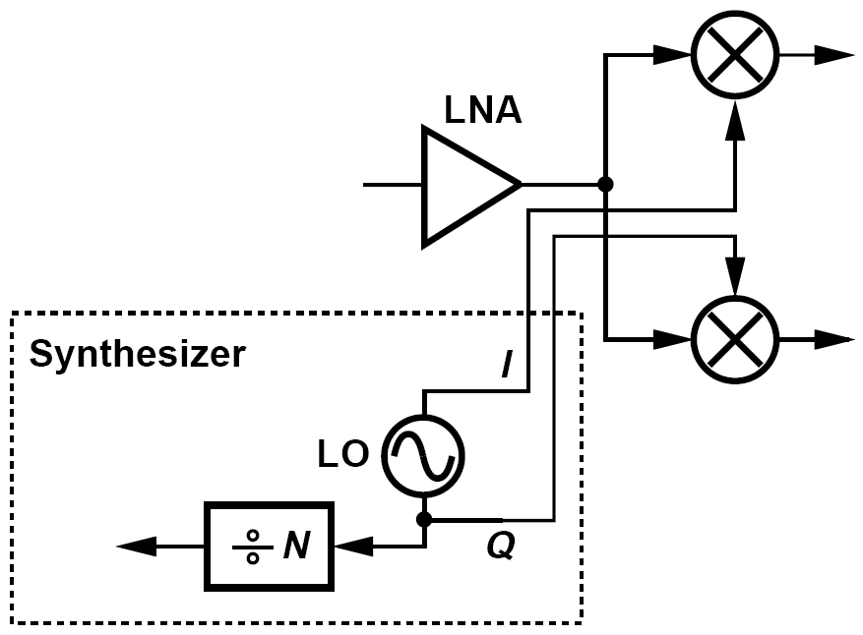
Performance Parameters: Output Voltage Swing & Drive Capability
The oscillators must produce sufficiently large output swings to ensure nearly complete switching of the transistors in the subsequent stages.
Furthermore, excessively low output swings exacerbate the effect of the internal noise of the oscillator.
In addition to the downconversion mixers, the oscillator must also drive a frequency divider, denoted by a ÷N block.

Slide 5
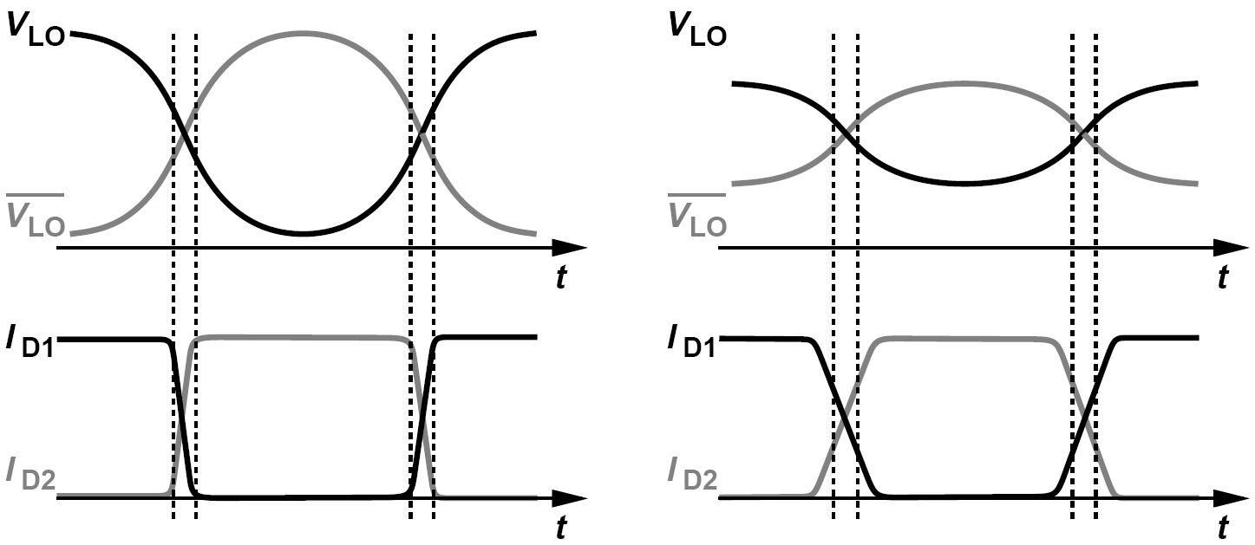
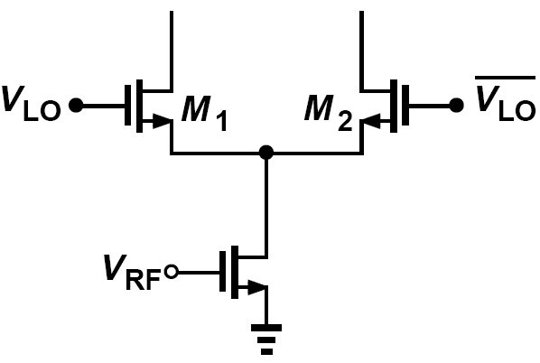
Performance Parameters: Drive Capability
Typical mixers and dividers exhibit a trade-off between the minimum LO swing with which they can operate properly and the capacitance that they present at their LO port.
We can select large LO swings so that V_{GS1}-V_{GS2} rapidly reaches a large value, turning off one transistor.
Alternatively, we can employ smaller LO swings but wider transistors so that they steer their current with a smaller differential input.
To alleviate the loading presented by mixers and dividers and perhaps amplify the swings, we can follow the LO with a buffer.

Slide 6
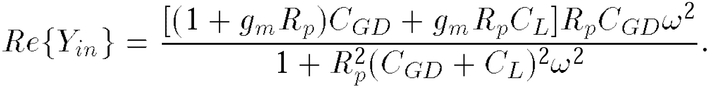
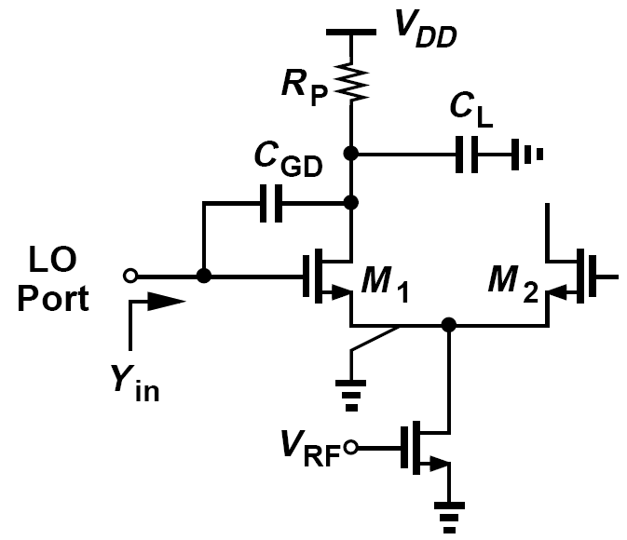
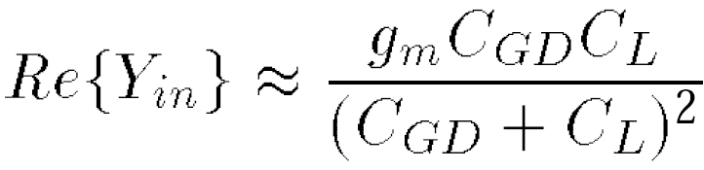
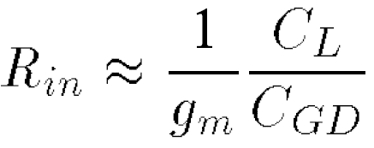
LO Port of Downconversion Mixers and Upconversion Mixers
Prove that the LO port of downconversion mixers presents a mostly capacitive impedance whereas that of upconversion mixers also contains a resistive component.
Here, R_{p} represents a physical load resistor in a downconversion mixer, forming a low-pass filter with C_{L}. In an upconversion mixer, on the other hand, R_{p} models the equivalent parallel resistance of a load inductor at resonance. the input admittance of the circuit and show that the real part reduces to
In a downconversion mixer, the -3-dB bandwidth at the output node is commensurate with the channel bandwidth and hence very small. That is, we can assume R_{p}C_{L} is very large,
Assume that C_{L} >> C_{GD} in a downconversion mixer
In an upconversion mixer, equation above may yield a substantially lower input resistance.

Slide 7
Performance Parameters: Phase Noise & Output Waveform
The spectrum of an oscillator in practice deviates from an impulse and is “broadened” by the noise of its constituent devices, called “phase noise”.
Unfortunately, phase noise bears direct trade-offs with the tuning range and power dissipation of oscillators, making the design more challenging.
Abrupt LO transitions reduce the noise and increase the conversion gain.
Effects such as direct feedthrough are suppressed if the LO signal has a 50% duty cycle.
Sharp transitions also improve the performance of frequency dividers.
Thus, the ideal LO waveform in most cases is a square wave.
In practice, it is difficult to generate square LO waveforms.
A number of considerations call for differential LO waveforms.

Slide 8
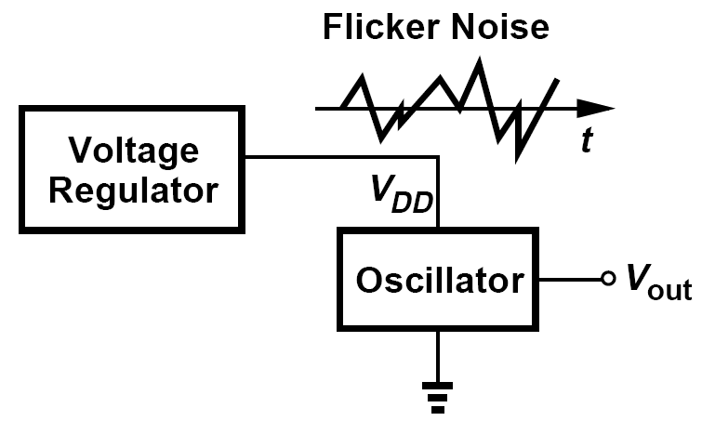
Performance Parameters: Supply Sensitivity & Power Dissipation
The frequency of an oscillator may vary with the supply voltage, an undesirable effect because it translates supply noise to frequency (and phase) noise.
The power drained by the LO and its buffer(s) proves critical in some applications as it trades with the phase noise and tuning range.

Slide 9
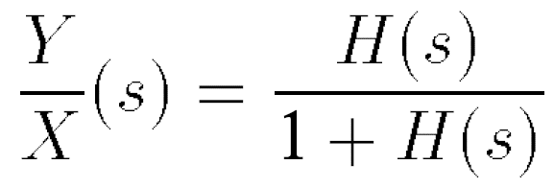
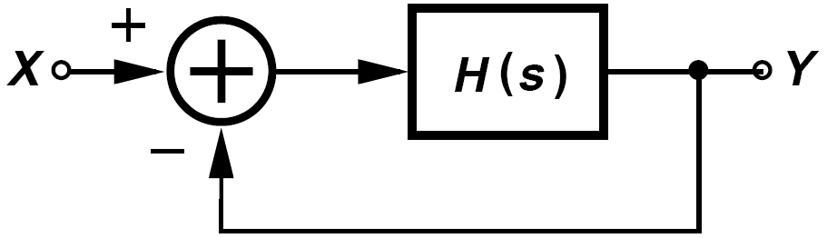
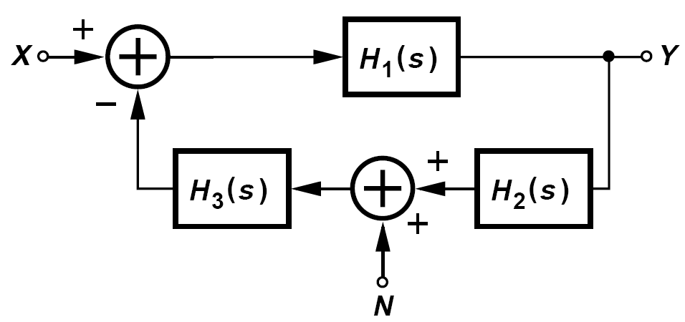
Feedback View of Oscillators
An oscillator may be viewed as a “badly-designed” negative-feedback amplifier—so badly designed that it has a zero or negative phase margin.
For the above system to oscillate, must the noise at ω₁ appear at the input?
No, the noise can be anywhere in the loop. For example, consider the system shown in figure below, where the noise N appears in the feedback path. Here,
Thus, if the loop transmission, H₁H₂H₃, approaches -1 at ω₁, N is also amplified indefinitely.

Slide 10
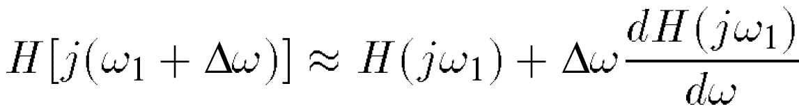
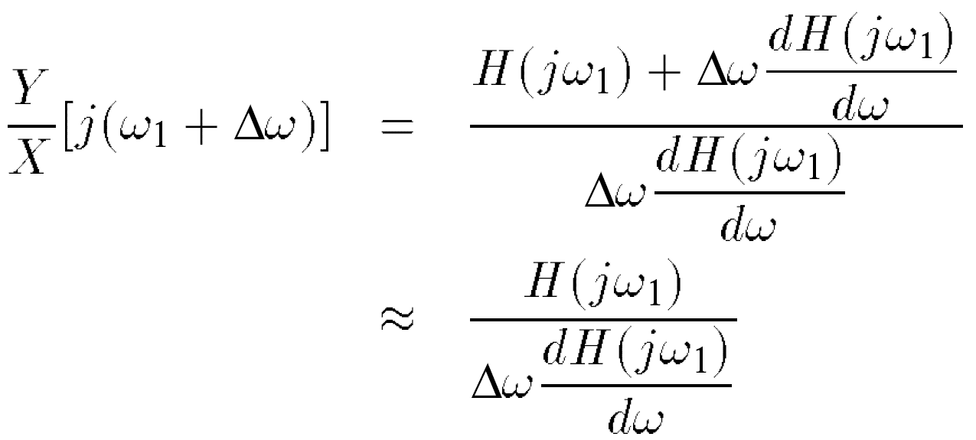
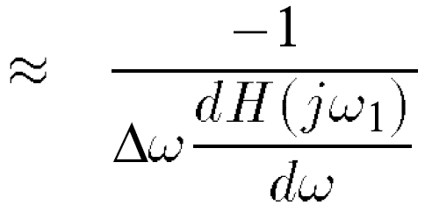
Y/X in the Vicinity of ω = ω₁
Derive an expression for Y/X in figure below in the vicinity of ω = ω₁ if H(jω₁) = -1.
We can approximate H(jω) by the first two terms in its Taylor series:
Since H(jω₁) = -1, we have
As expected, Y/X → ∞ as Δω → 0, with a “sharpness” proportional to dH/dω.

Slide 11
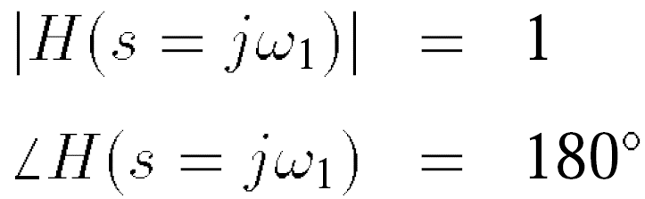
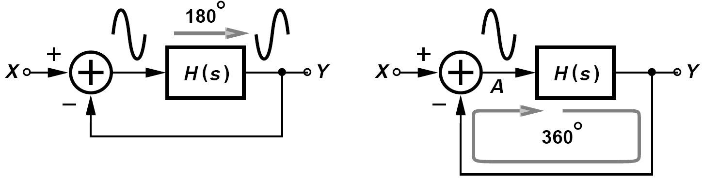
Barkhausen’s Criteria
For the circuit to reach steady state, the signal returning to A must exactly coincide with the signal that started at A. We call ∠ H(jω₁) a “frequency-dependent” phase shift to distinguish it from the 180 ° phase due to negative feedback.
Even though the system was originally configured to have negative feedback, H(s) is so “sluggish” that it contributes an additional phase shift of 180 ° at ω₁, thereby creating positive feedback at this frequency.

Slide 12
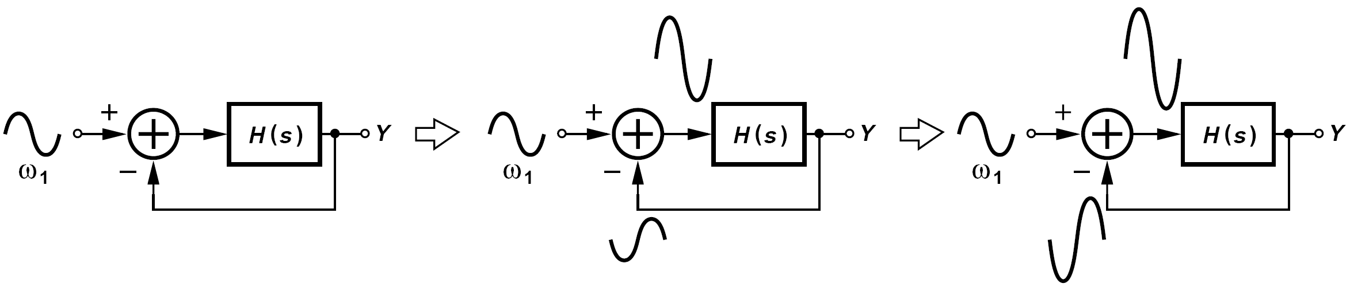
Significance of |H(jw₁)| = 1
For a noise component at ω₁ to “build up” as it circulates around the loop with positive feedback, the loop gain must be at least unity.
We call |H(jω₁)| = 1 the “startup” condition.
What happens if |H(jω₁)| > 1 and ∠H(jω₁) = 180°? The growth shown in figure above still occurs but at a faster rate because the returning waveform is amplified by the loop.
Note that the closed-loop poles now lie in the right half plane.

Slide 13
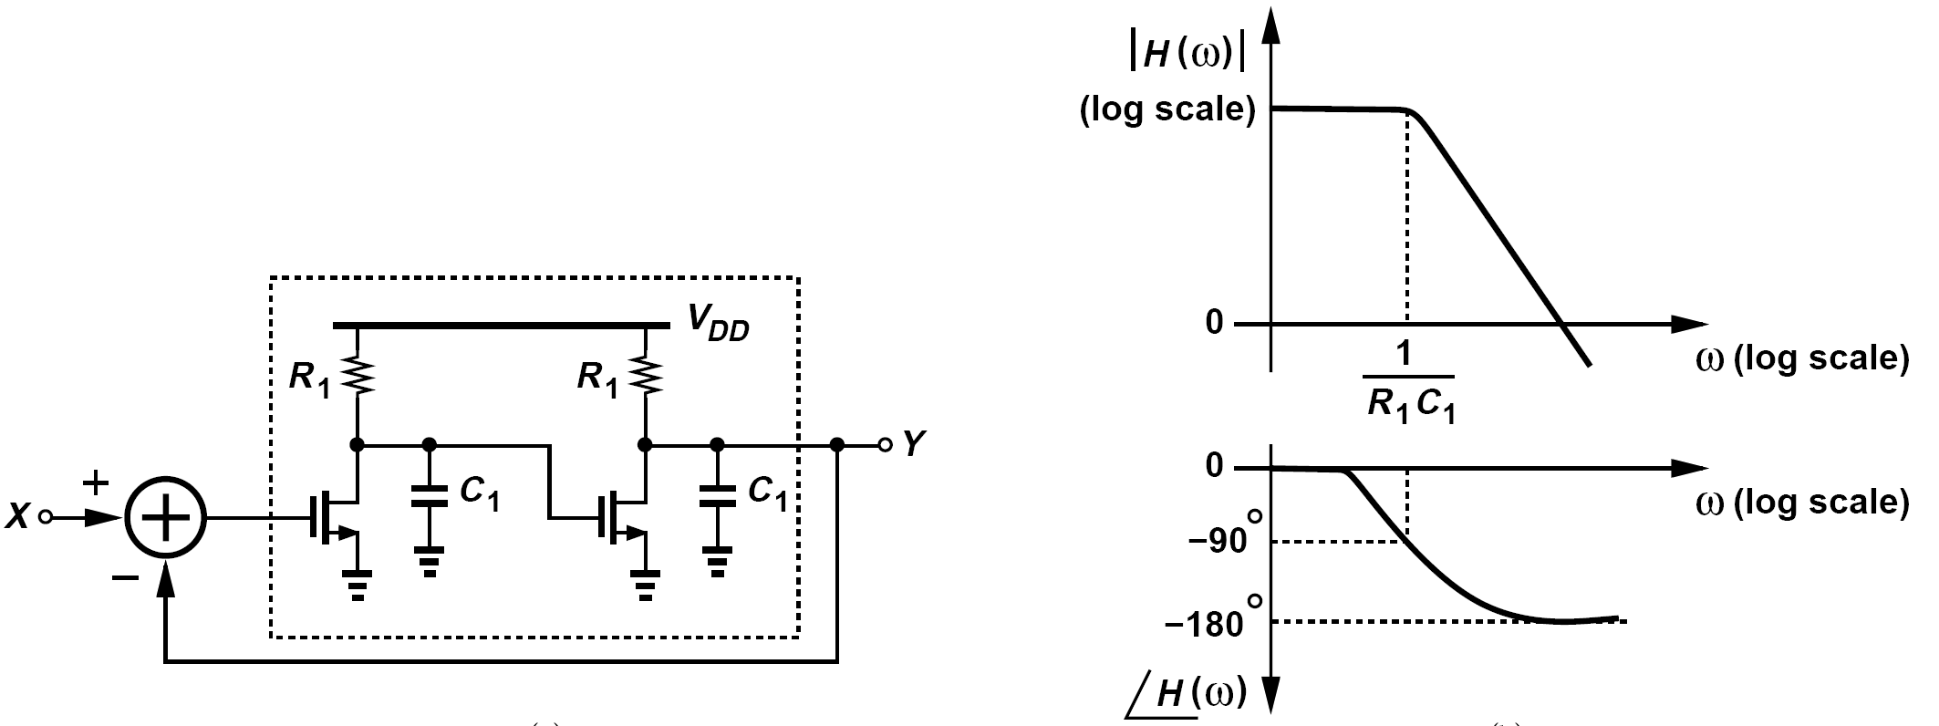
Can a Two-Pole System Oscillate? (Ⅰ)
Can a two-pole system oscillate?
Suppose the system exhibits two coincident real poles at ω_{p}. Figure below (left) shows an example, where two cascaded common-source stages constitute H(s) and ω_{p} = (R₁C₁)-1. This system cannot satisfy both of Barkhausen’s criteria because the phase shift associated with each stage reaches 90° only at ω = ∞, but |H(∞)| = 0. Figure below (right) plots |H| and ∠H as a function of frequency, revealing no frequency at which both conditions are met. Thus, the circuit cannot oscillate.

Slide 14
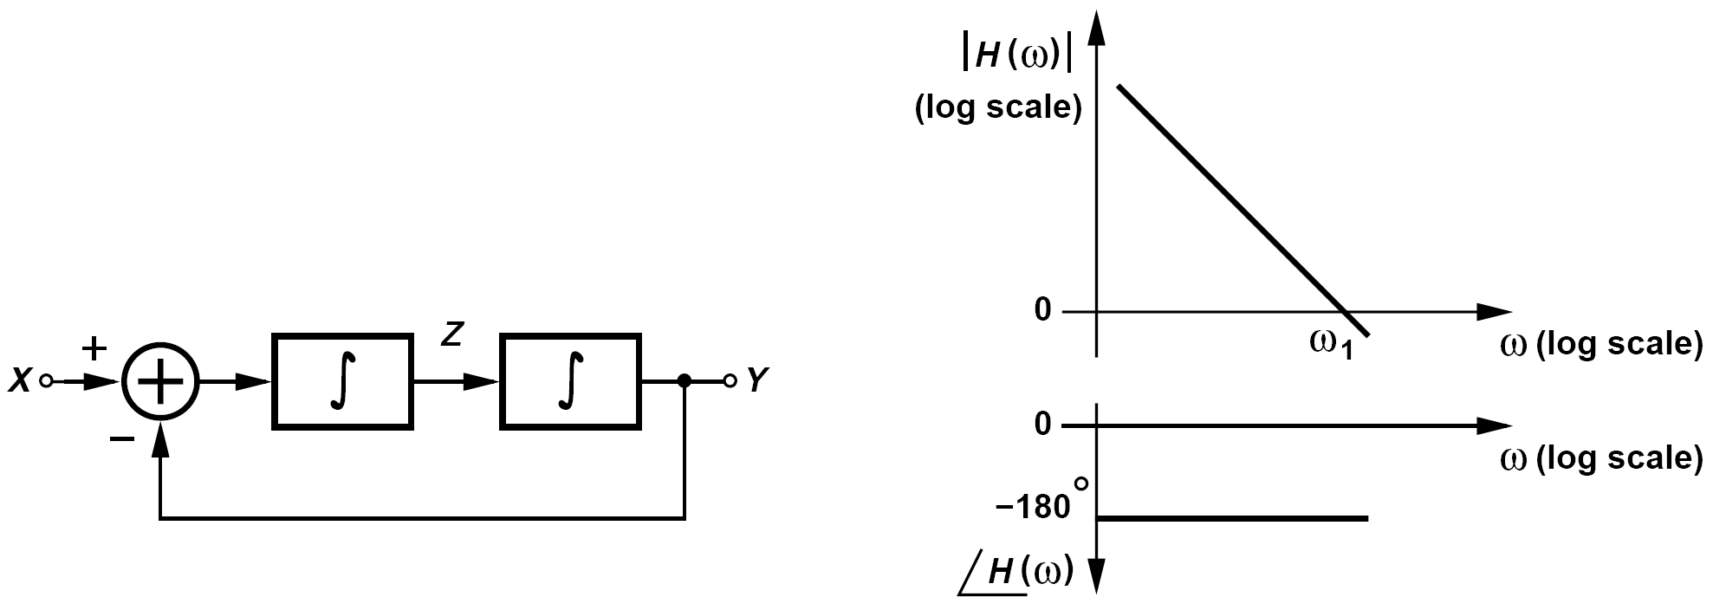
Can a Two-Pole System Oscillate? (Ⅱ)
Can a two-pole system oscillate?
But, what if both poles are located at the origin? Realized as two ideal integrators in a loop, such a circuit does oscillate because each integrator contributes a phase shift of -90° at any nonzero frequency. Shown in figure below (right) are |H| and ∠H for this system.

Slide 15
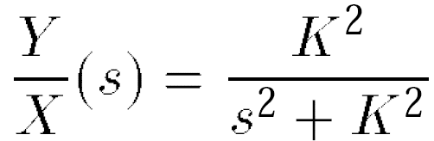
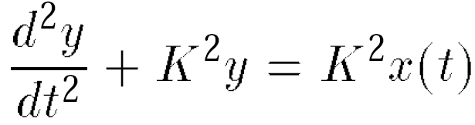

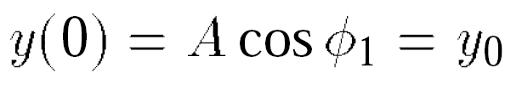
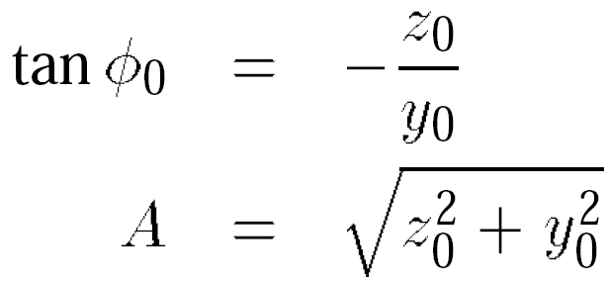
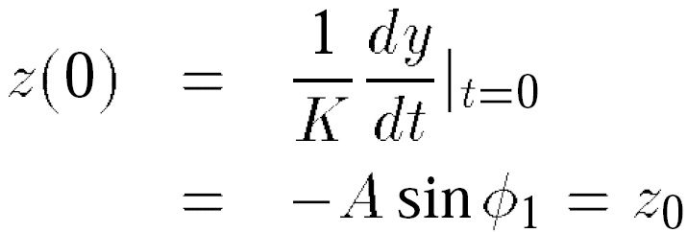
Frequency and Amplitude of Oscillation in Previous Example
The feedback loop of figure above is released at t = 0 with initial conditions of z₀ and y₀ at the outputs of the two integrators and x(t) = 0. Determine the frequency and amplitude of oscillation.
Assuming each integrator transfer function is expressed as K/s,
Substitute x and y,
Interestingly, the circuit automatically finds the frequency at which the loop gain K2/ω2 drops to unity.

Slide 16
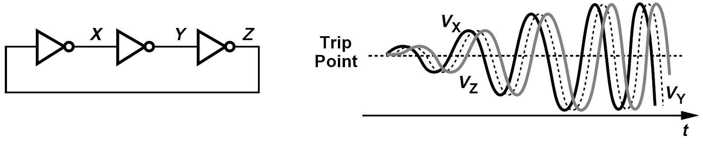
Ring Oscillator
Other oscillators may begin to oscillate at a frequency at which the loop gain is higher than unity, thereby experiencing an exponential growth in their output amplitude.
The growth eventually stops due to the saturating behavior of the amplifier(s) in the loop.
Each stage operates as an amplifier, leading to an oscillation frequency at which each inverter contributes a frequency-dependent phase shift of 60°.

Slide 17

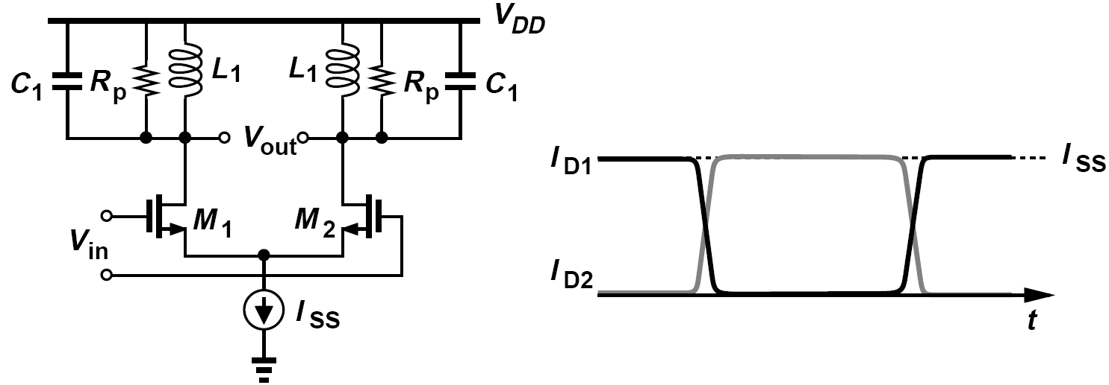
Example of Voltage Swings (Ⅰ)
The inductively-loaded differential pair shown in figure below is driven by a large input sinusoid at
Plot the output waveforms and determine the output swing.
With large input swings, M₁ and M₂ experience complete switching in a short transition time, injecting nearly square current waveforms into the tanks. Each drain current waveform has an average of I_{SS}/2 and a peak amplitude of I_{SS}/2. The first harmonic of the current is multiplied by R_{p} whereas higher harmonics are attenuated by the tank selectivity.

Slide 18
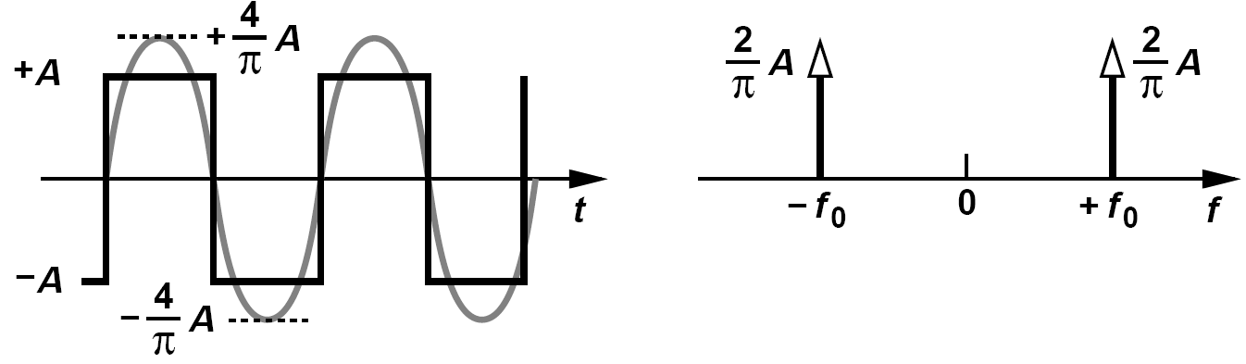
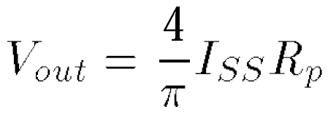
Example of Voltage Swings (Ⅱ)
Recall from the Fourier expansion of a square wave of peak amplitude A (with 50% duty cycle) that the first harmonic exhibits a peak amplitude of (4/π)A (slightly greater than A). The peak single-ended output swing therefore yields a peak differential output swing of

Slide 19
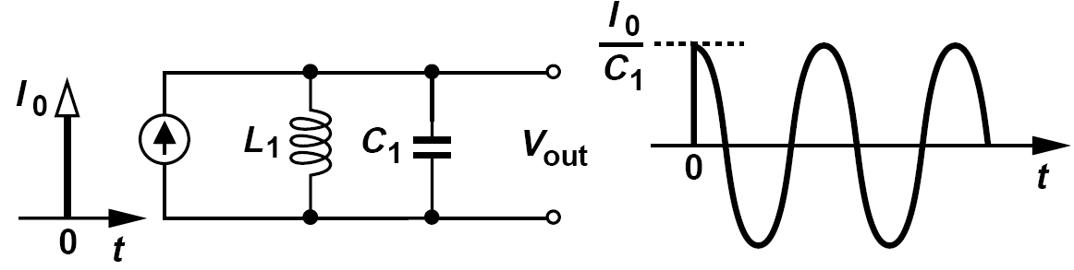
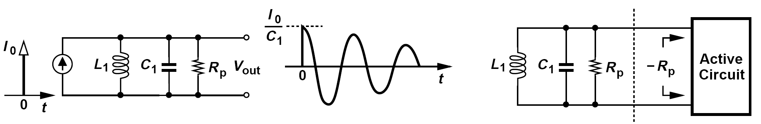
One-Port View of Oscillators
An alternative perspective views oscillators as two one-port components, namely, a lossy resonator and an active circuit that cancels the loss.
If an active circuit replenishes the energy lost in each period, then the oscillation can be sustained.
In fact, we predict that an active circuit exhibiting an input resistance of -R_{p} can be attached across the tank to cancel the effect of R_{p}.

Slide 20
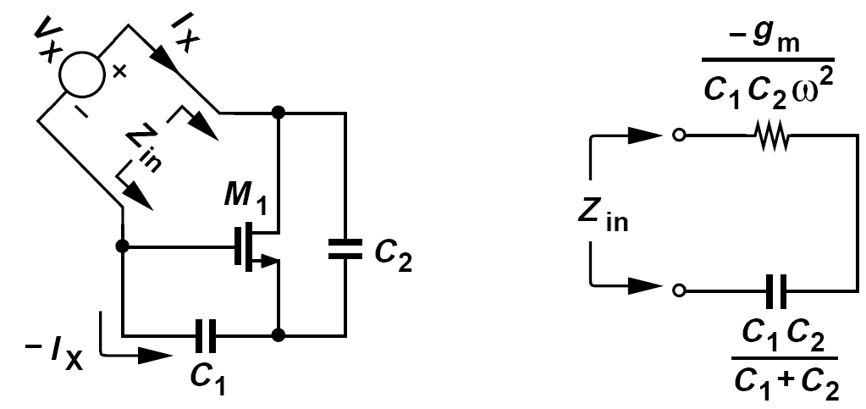
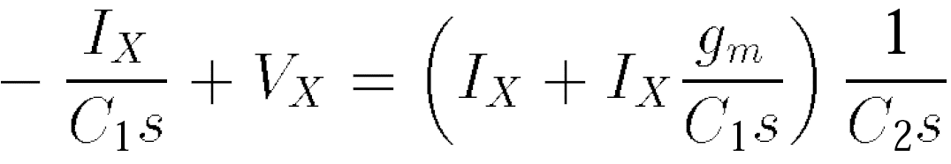
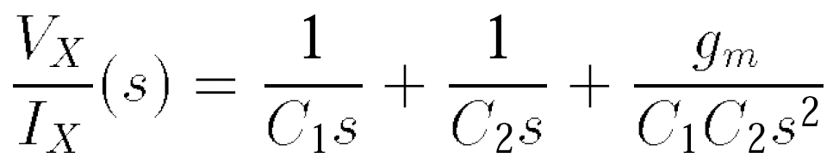
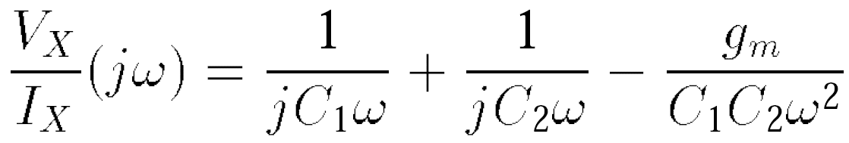
How Can a Circuit Present a Negative Input Resistance?
The negative resistance varies with frequency.

Slide 21
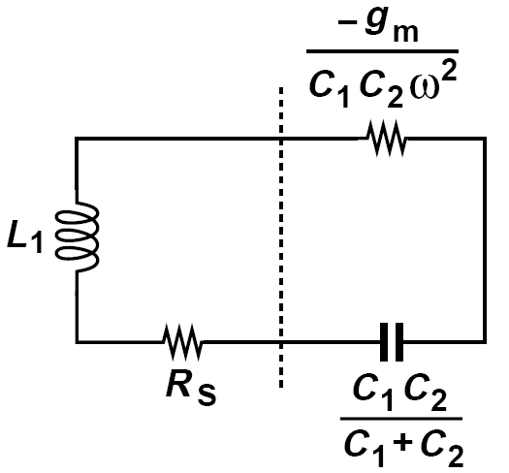
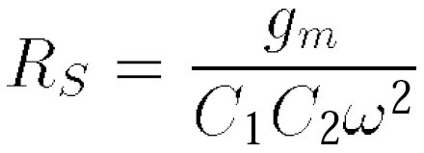
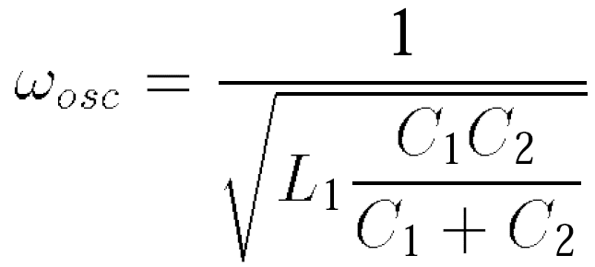
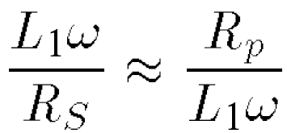
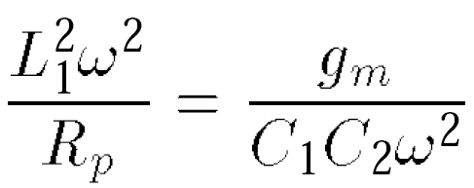
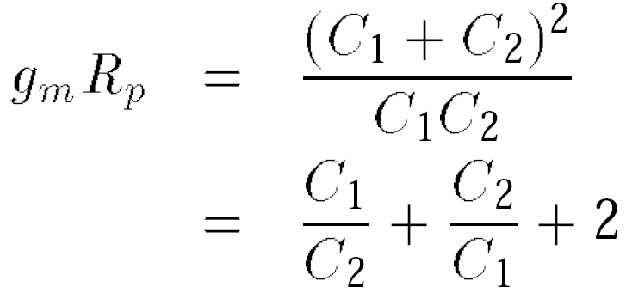
Connection of Lossy Inductor to Negative-Resistance Circuit
Since the capacitive component in equation above can become part of the tank, we simply connect an inductor to the negative-resistance port.
Express the oscillation condition in terms of inductor’s parallel equivalent resistance, R_{p}, rather than R_{S}.
The startup condition:

Slide 22
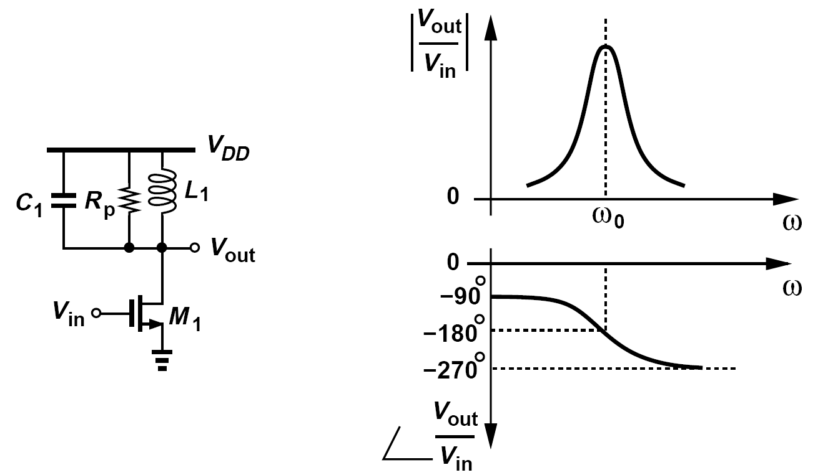
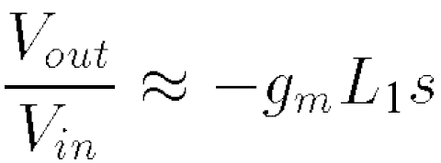
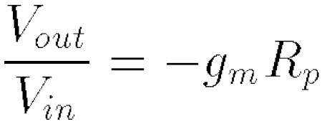
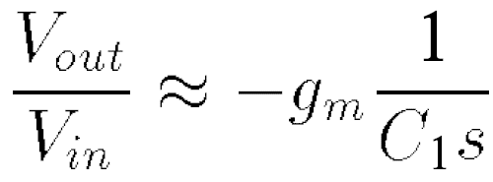
Tuned Oscillator
We wish to build a negative-feedback oscillatory system using “LC-tuned” amplifier stages.
At very low frequencies, L₁ dominates the load and
At the resonance frequency
At very high frequencies
|V_{out}/V_{in}| is very small and ∠(V_{out}/V_{in}) remains around -90°
The phase shift from the input to the output is thus equal to 180°
|V_{out}/V_{in}| dinimishes ∠(V_{out}/V_{in}) approaches +90°

Slide 23
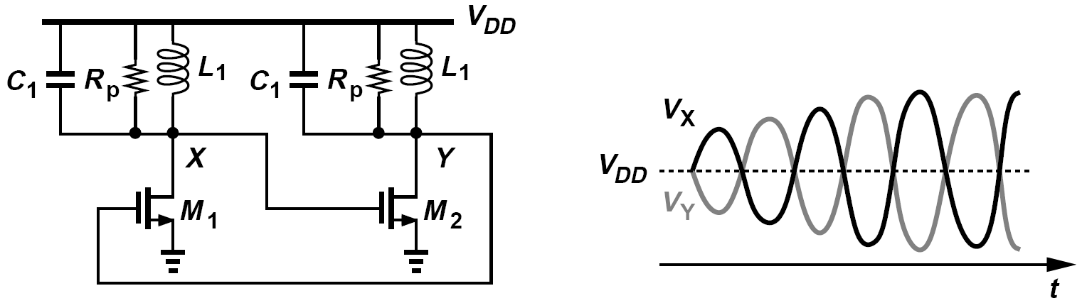
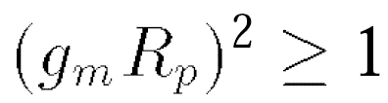
Cascade of Two Tuned Amplifiers in Feedback Loop
Can the circuit above oscillate if its input and output are shorted? No.
We recognize that the circuit provides a phase shift of 180 ° with possibly adequate gain (g_{m}R_{p}) at ω₀. We simply need to increase the phase shift to 360 °.
Assuming that the circuit above (left) oscillates, plot the voltage waveforms at X and Y.
Wave form is shown above (right). A unique attribute of inductive loads is that they can provide peak voltages above the supply. The growth of V_{X} and V_{Y} ceases when M₁ and M₂ enter the triode region for part of the period, reducing the loop gain.

Slide 24
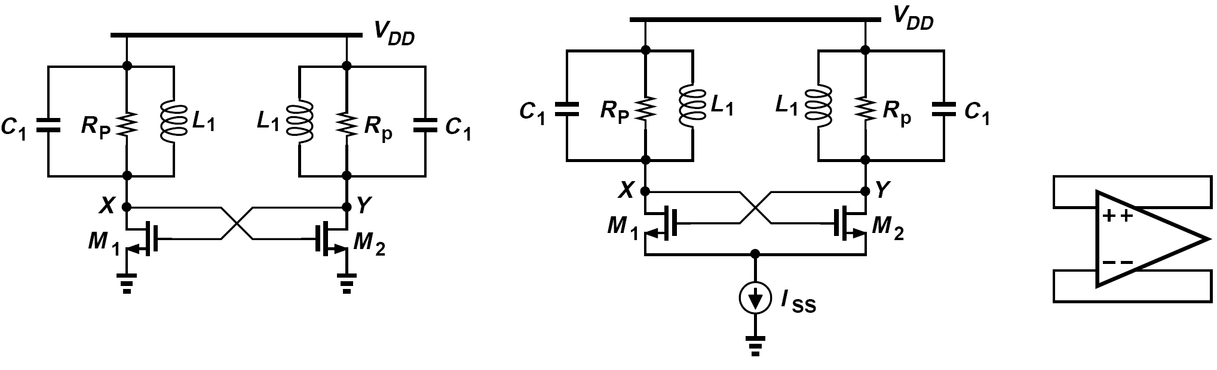
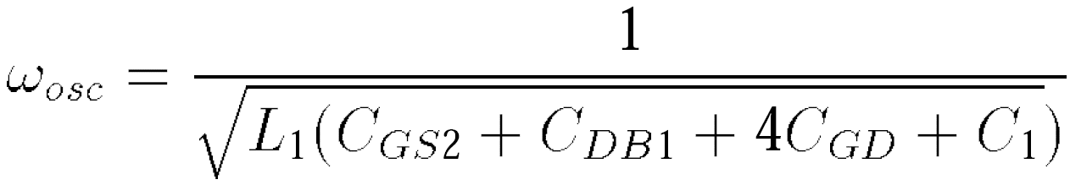
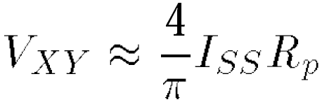
Cross-Coupled Oscillator
The oscillator above (left) suffers from poorly-defined bias currents. The circuit above (middle) is more robust and can be viewed as an inductively-loaded differential pair with positive feedback.
Compute the voltage swings in the circuit above (middle) if M₁ and M₂ experience complete current switching with abrupt edges.

Slide 25

Above-Supply Swings in Cross-Coupled Oscillator
Each transistor may experience stress under the following conditions:
(1) The drain reaches V_{DD}+V_{a}. The transistor remains off but its drain-gate voltage is equal to 2V_{a} and its drain-source voltage is greater than 2V_{a.}
(2) The drain falls to V_{DD} - V_{a} while the gate rises to V_{DD} + V_{a}. Thus, the gate-drain voltage reaches 2V_{a} and the gate-source voltage exceeds 2V_{a}.
Proper choice of V_{a}, I_{SS}, and device dimensions avoids stressing the transistors.

Slide 26

Example of Supply Sensitivity of Cross-Coupled Oscillator
A student claims that the cross-coupled oscillator below exhibits no supply sensitivity if the tail current source is ideal. Is this true?
No, it is not. The drain-substrate capacitance of each transistor sustains an average voltage equal to V_{DD}. Thus, supply variations modulate this capacitance and hence the oscillation frequency.

Slide 27






One-Port View of Cross-Coupled Oscillator
For g_{m1} = g_{m2} =g_{m}
For oscillation to occur, the negative resistance must cancel the loss of the tank:

Slide 28


Three-Point Oscillators
Three different oscillator topologies can be obtained by grounding each of the transistor terminals. Figures below depict the resulting circuits if the source, the gate, or the drain is (ac) grounded, respectively.
If C₁ = C₂, the transistor must provide sufficient transconductance to satisfy
The circuits above may fail to oscillate if the inductor Q is not very high.

Slide 29

Differential Version of Three-Point Oscillators
Another drawback of the circuits shown above is that they produce only single-ended outputs. It is possible to couple two copies of one oscillator so that they operate differentially.
If chosen properly, the resistor R₁ prohibits common-mode oscillation.
Even with differential outputs, the circuit above may be inferior to the cross-coupled oscillator previous discussed —not only for the more stringent start-up condition but also because the noise of I₁ and I₂ directly corrupts the oscillation.

Slide 30


Voltage-Controlled Oscillators: Characteristic
The output frequency varies from ω₁ to ω₂ (the required tuning range) as the control voltage, V_{cont}, goes from V₁ to V₂.
The slope of the characteristic, K_{VCO}, is called the “gain” or “sensitivity” of the VCO and expressed in rad/Hz/V.

Slide 31




Example: V_{DD} as the “Control Voltage”
As explained in previous example, the cross-coupled oscillator exhibits sensitivity to V_{DD}. Considering V_{DD} as the “control voltage,” determine the gain.
If C₁ includes all circuit capacitances except C_{DB}
The junction capacitance is approximated as

Slide 32


VCO Using MOS Varactors
Since it is difficult to vary the inductance electronically, we only vary the capacitance by means of a varactor.
MOS varactors are more commonly used than pn junctions, especially in low-voltage design.
First, the varactors are stressed for part of the period if V_{cont} is near ground and V_{X} (or V_{Y} ) rises significantly above V_{DD}.
Second, only about half of C_{max} - C_{min} is utilized in the tuning.

Slide 33


Oscillator Using Symmetric Inductor
Symmetric spiral inductors excited by differential waveforms exhibit a higher Q than their single-ended counterparts.
The symmetric inductor above has a value of 2 nH and a Q of 10 at 10 GHz. What is the minimum required transconductance of M₁ and M₂ to guarantee start-up?

Slide 34



Tuning Range Limitations
We make a crude approximation, C_{var} << C₁, and
If the varactor capacitance varies from C_{var1} to C_{var2}, then the tuning range is given by
The tuning range trades with the overall tank Q.
Another limitation on C_{var2} - C_{var1} arises from the available range for the control voltage of the oscillator, V_{cont.}

Slide 35




Effect of Varactor Q: Tank Consisting of Lossy Inductor and Capacitor
A lossy inductor and a lossy capacitor form a parallel tank. Determine the overall Q in terms of the quality factor of each.
The loss of an inductor or a capacitor can be modeled by a parallel resistance (for a narrow frequency range). We therefore construct the tank as shown below, where the inductor and capacitor Q’s are respectively given by:
Merging R_{p1} and R_{p2} yields the overall Q:

Slide 36






Tank Using Lossy Varactor
Transforming the series combination of C_{var} and R_{var} to a parallel combination
The Q associated with C₁+C_{var} is equal to
The overall tank Q is therefore given by
Equation above can be generalized if the tank consists of an ideal capacitor, C₁, and lossy
capacitors, C₂-C_{n}, that exhibit a series resistance of R₂-R_{n}, respectively.

Slide 37


LC VCOs with Wide Tuning Range: VCOs with Continuous Tuning
We seek oscillator topologies that allow both positive and negative (average) voltages across the varactors, utilizing almost the entire range from C_{min} to C_{max}.
The CM level is simply given by the gate-source voltage of a diode-connected transistor carrying a current of I_{DD}/2.
We select the transistor dimensions such that the CM level is approximately equal to V_{DD}/2.
Consequently, as V_{cont} varies from 0 to V_{DD}, the gate-source voltage of the varactors, V_{GS,var}, goes from +V_{DD}/2 to –V_{DD}/2,

Slide 38


Output CM Dependence on Bias Current
The tail or top bias current in the above oscillators is changed by DI. Determine the change in the voltage across the varactors.
Each inductor contains a small low-frequency resistance, r_{s} . If I_{SS} changes by ΔI, the output CM level changes by ΔV_{CM} = (ΔI/2)r_{s}, and so does the voltage across each varactor. In the top-biased circuit, on the other hand, a change of ΔI flows through two diode-connected transistors, producing an output CM change of ΔV_{CM} = (ΔI/2)(1/g_{m}). Since 1/g_{m} is typically in the range of a few hundred ohms, the top-biased topology suffers from a much higher varactor voltage modulation.
What is the change in the oscillation frequency in the above example?
Since a CM change at X and Y is indistinguishable from a change in V_{cont}, we have

Slide 39


VCO Using Capacitor Coupling to Varactors
In order to avoid varactor modulation due to the noise of the bias current source, we return to the tail-biased topology but employ ac coupling between the varactors and the core so as to allow positive and negative voltages across the varactors.
The principal drawback of the above circuit stems from the parasitics of the coupling capacitors.

Slide 40

VCO Using Capacitor Coupling to Varactors: Parasitic Capacitances to the Substrate
The choice of C_{S} = 10C_{max} reduces the capacitance range by 10% but introduces substantial parasitic capacitances at X and Y or at P and Q because integrated capacitors suffer from parasitic capacitances to the substrate.
C_{b}/C_{AB} typically exceeds 5%.

Slide 41




VCO Using Capacitor Coupling to Varactors: Effect of the Parasitics of C_{S1} and C_{S2}
A larger C₁ further limits the tuning range.
The VCO above is designed for a tuning range of 10% without the series effect of C_{S} and parallel effect of C_{b}. If C_{S} = 10C_{max}, C_{max} = 2C_{min}, and C_{b} = 0.05C_{S}, determine the actual tuning range.
Without the effects of C_{S} and C_{b}
For this range to reach 10% of the center frequency, we have
With the effects of C_{S} and C_{b}

Slide 42

Fringe Capacitor
Called a “fringe” or “lateral-field” capacitor, this topology incorporates closely-spaced narrow metal lines to maximize the fringe capacitance between them. The capacitance per unit volume is larger than that of the metal sandwich, leading to a smaller parasitic.

Slide 43

VCO Using NMOS and PMOS Cross-Coupled Pairs
The circuit can be viewed as two back-to-back CMOS inverters, except that the sources of the NMOS devices are tied to a tail current, or as a cross-coupled NMOS pair and a cross-coupled PMOS pair sharing the same bias current.
Proper choice of device dimensions and I_{SS} can yield a CM level at X and Y around V_{DD}/2, thereby maximizing the tuning range.

Slide 44

VCO Using NMOS and PMOS Cross-Coupled Pairs: the Voltage Swing Advantage
An important advantage of the above topology over those previous discussed is that it produces twice the voltage swing for a given bias current and inductor design.
The current in each tank swings between +I_{SS} and -I_{SS} whereas in previous topologies it swings between I_{SS} and zero. The output voltage swing is therefore doubled.

Slide 45

VCO Using NMOS and PMOS Cross-Coupled Pairs: Drawbacks
First, for |V_{GS3}|+V_{GS1}+V_{ISS} to be equal to V_{DD}, the PMOS transistors must typically be quite wide, contributing significant capacitance and limiting the tuning range.
Second, the noise current of the bias current source modulates the output CM level and hence the capacitance of the varactors, producing frequency and phase noise.
A student attempts to remove the noise of the tail current source by simply eliminating it. Explain the pros and cons of such a topology.
The circuit indeed avoids frequency modulation due to the tail current noise. Moreover, it saves the voltage headroom associated with the tail current source. However, the circuit is now very sensitive to the supply voltage. For example, a voltage regulator providing V_{DD} may exhibit significant flicker noise, thus modulating the frequency (by modulating the CM level). Furthermore, the bias current of the circuit varies considerably with process and temperature.

Slide 46


Amplitude Variation with Frequency Tuning
In addition to the narrow varactor capacitance range, another factor that limits the useful tuning range is the variation of the oscillation amplitude.
As the capacitance attached to the tank increases, the amplitude tends to decrease.
Suppose the tank inductor exhibits only a series resistance, R_{S}
Thus, R_{p} falls in proportion to ω2 as more capacitance is presented to the tank.

Slide 47



Discrete Tuning
In applications where a substantially wider tuning range is necessary, “discrete tuning” may be added to the VCO so as to achieve a capacitance range well beyond C_{max}/C_{min} of varactors.
The lowest frequency is obtained if all of the capacitors are switched in and the varactor is at its maximum value,
The highest frequency occurs if the unit capacitors are switched out and the varactor is at its minimum value,

Slide 48




Discrete Tuning: Variation of Fine Tuning Range
Consider the characteristics above more carefully. Does the continuous tuning range remain the same across the discrete tuning range? That is, can we say Δω_{osc1} ≈ Δω_{osc2}?
We expect Δω_{osc1} to be greater than Δω_{osc2} because, with nC_{u} switched into the tanks, the varactor sees a larger constant capacitance. In fact,
This variation in K_{VCO} proves undesirable in PLL design.

Slide 49


Discrete Tuning: Issue of R_{on} (Ⅰ)
The on resistance, R_{on}, of the switches that control the unit capacitors degrades the Q of the tank.

Slide 50


Issue of R_{on} (Ⅱ): Effect of Switch Parasitic Capacitances
Can we simply increase the width of the switch transistors so as to minimize the effect of R_{on}?
Wider switches introduce a larger capacitance from the bottom plate of the unit capacitors to ground, thereby presenting a substantial capacitance to the tanks when the switches are off.
This trade-off between the Q and the tuning range limits the use of discrete tuning.

Slide 51

Issue of R_{on} (Ⅲ): Use of Floating Switch
The problem of switch on-resistance can be alleviated by exploiting the differential operation of the oscillator.
The idea is to place the main switch, S₁, between nodes A and B so that, with differential swings at these nodes, only half of R_{on1} appears in series with each unit capacitor.

Slide 52

Issue of Discrete Tuning: Blind Zone
The oscillator fails to cover the range between ω₂ and ω₃ for any combination of fine and
coarse controls.
To avoid blind zones, each two consecutive tuning characteristics must have some overlap.
This precaution translates to smaller unit capacitors but a larger number of them and hence a complex layout.

Slide 53


Phase Noise: Basic Concepts
The noise of the oscillator devices randomly perturbs the zero crossings. To model this perturbation, we write x(t) = Acos[ω_{c}t + Φ_{n}(t)], The term Φ_{n}(t) is called the “phase noise.”
From another perspective, the frequency experiences random variations, i.e., it departs from ω_{c} occasionally.

Slide 54



Phase Noise: Declining Phase Noise “Skirts”
Explain why the broadened impulse cannot assume the shape shown below.
This spectrum occurs if the oscillator frequency has equal probability of appearing anywhere between ω_{c} - Δω and ω_{c} + Δω. However, we intuitively expect that the oscillator prefers ω_{c} to other frequencies, thus spending lesser time at frequencies that are farther from ω_{c}. This explains the declining phase noise “skirts”.
The spectrum can be related to the time-domain expression.

Slide 55

Various Factors of 4 and 2
(1) since Φ_{n}(t) in equation above is multiplied by sin ω_{c}t, its power spectral density, S_{Φn}, is multiplied by 1/4 as it is translated to ±ω_{c};
(2) A spectrum analyzer measuring the resulting spectrum folds the negative frequency spectrum atop the positive-frequency spectrum, raising the spectral density by a factor of 2.

Slide 56

How is the Phase Noise Quantified?
Since the phase noise falls at frequencies farther from ω_{c}, it must be specified at a certain “frequency offset,” i.e., a certain difference with respect to ω_{c}.
We consider a 1-Hz bandwidth of the spectrum at an offset of Δf, measure the power in this bandwidth, and normalize the result to the “carrier power”, called “dB with respect to the carrier”.
In practice, the phase noise reaches a constant floor at large frequency offsets (beyond a few megahertz).
We call the regions near and far from the carrier the “close-in” and the “far-out” phase noise, respectively.

Slide 57

Specification of Phase Noise
At high carrier frequencies, it is difficult to measure the noise power in a 1-Hz bandwidth. Suppose a spectrum analyzer measures a noise power of -70 dBm in a 1-kHz bandwidth at 1-MHz offset. How much is the phase noise at this offset if the average oscillator output power is -2 dBm?
Since a 1-kHz bandwidth carries 10 log(1000 Hz) = 30 dB higher noise than a 1-Hz bandwidth, we conclude that the noise power in 1 Hz is equal to -100 dBm. Normalized to the carrier power, this value translates to a phase noise of -98 dBc/Hz.

Slide 58

Effect of Phase Noise: Reciprocal Mixing
Referring to the ideal case depicted above (middle), we observe that the desired channel is convolved with the impulse at ω_{LO}, yielding an IF signal at ω_{IF} = ω_{in} - ω_{LO}.
Now, suppose the LO suffers from phase noise and the desired signal is accompanied by a large interferer. The convolution of the desired signal and the interferer with the noisy LO spectrum results in a broadened downconverted interferer whose noise skirt corrupts the desired IF signal.
This phenomenon is called “reciprocal mixing.”

Slide 59






Example of Reciprocal Mixing
A GSM receiver must withstand an interferer located three channels away from the desired channel and 45 dB higher. Estimate the maximum tolerable phase noise of the LO if the corruption due to reciprocal mixing must remain 15 dB below the desired signal.
The total noise power introduced by the interferer in the desired channel is equal to
For simplicity, we assume S_{n}(f) is relatively flat in this bandwidth and equal to S₀,
which must be at least 15 dB.
If f_{H} - f_{L} = 200 kHz, then

Slide 60

Received Noise due to Phase Noise of an Unwanted Signal
In figure below, two users are located in close proximity, with user #1 transmitting a high-power signal at f₁ and user #2 receiving this signal and a weak signal at f₂. If f₁ and f₂ are only a few channels apart, the phase noise skirt masking the signal received by user #2 greatly corrupts it even before downconversion.
A student reasons that, if the interferer at f₁ above is so large that its phase noise corrupts the reception by user #2, then it also heavily compresses the receiver of user #2. Is this true?
Not necessarily. An interferer, say, 50 dB above the desired signal produces phase noise skirts that are not negligible. For example, the desired signal may have a level of -90 dBm and the interferer, -40 dBm. Since most receivers’ 1-dB compression point is well above -40 dBm, user #2’s receiver experiences no desensitization, but the phenomenon above is still critical.

Slide 61

Corruption of a QPSK Signal due to Phase Noise
Since the phase noise is indistinguishable from phase (or frequency) modulation, the mixing of the signal with a noisy LO in the TX or RX path corrupts the information carried by the signal.
The constellation points experience only random rotation around the origin. If large enough, phase noise and other nonidealities move a constellation point to another quadrant, creating an error.

Slide 62

Phase Noise Corruption on 16-QAM Constellation
Which points in a 16-QAM constellation are most sensitive to phase noise?
Consider the four points in the top right quadrant. Points B and C can tolerate a rotation of 45° before they move to adjacent quadrants. Points A and D, on the other hand, can rotate by only θ = tan-1(1/3) = 18.4°. Thus, the eight outer points near the I and Q axes are most sensitive to phase noise.

Slide 63


Analysis of Phase Noise: Approach I --- Q of an Oscillator
Another definition of the Q that is especially well-suited to oscillators is shown above, where the circuit is viewed as a feedback system and the phase of the open-loop transfer function, is examined at the resonance frequency.
Oscillators with a high open-loop Q tend to spend less time at frequencies other than ω₀.

Slide 64




Open-Loop Model of a Cross-Coupled Oscillator
Compute the open-loop Q of a cross-coupled LC oscillator.
Since at s = jω,
We have
This result is to be expected: the cascade of frequency-selective stages makes the phase transition sharper than that of one stage.

Slide 65





Noise Shaping in Oscillators(Ⅰ)
In the vicinity of the oscillation frequency, we can approximate H(jω) with the first two terms in its Taylor series:
If H(jω₀) = -1 and ΔωdH/dω << 1,
The noise spectrum is “shaped” by

Slide 66




Noise Shaping in Oscillators (Ⅱ)
To determine the shape of |dH/dω|2, we write H(jω) in polar form, and differentiate with respect to ω,
Note that (a) in an LC oscillator, the term |d|H|/dω|2 is much less than |dΦ/dω|2 in the vicinity of the resonance frequency, and (b) |H| is close to unity for steady oscillations.
Known as “Leeson’s Equation”, this result reaffirms our intuition that the open-loop Q signifies how much the oscillator rejects the noise.

Slide 67




Apparently Infinite Q in an Oscillator
A student designs the cross-coupled oscillator below with 2/g_{m} = 2Rp, reasoning that the tank now has infinite Q and hence the oscillator produces no phase noise! Explain the flaw in this argument.
The Q in equation above is the open-loop Q, i.e., ω₀/2 times the slope of the phase of the open-loop transfer function, which was calculated in previous example. The “closed-loop” Q does not carry much meaning.
If the feedback path has a transfer function G(s), then

Slide 68


Linear Model (Ⅰ)
The small-signal (linear) model may ignore some important effects, e.g., the noise of the tail current source, or face other difficulties.
Compute the total noise injected to the differential output of the cross-coupled oscillator when the transistors are in equilibrium. Note that the two-sided spectral density of the drain current noise is equal to I_{n}2 = 2kTγg_{m}.
The output noise is obtained as

Slide 69


Linear Model (Ⅱ)
Since I_{n1} and I_{n2} are uncorrelated
Unfortunately, this result contradicts Leeson’s equation. g_{m} is typically quite higher than 2/R_{p} and hence R ≠ ∞.

Slide 70


Conversion of Additive Noise to Phase Noise
At any point in time, the small phasor can be expressed as the sum of two other phasors, one aligned with A and the other perpendicular to it. The former modulates the amplitude and the latter, the phase.
The output of the limiter can be written as
We expect that narrowband random additive noise in the vicinity of ω₀ results in a phase whose spectrum has the same shape as that of the additive noise but translated by ω₀ and normalized to A/2.

Slide 71




Conversion of Additive Noise to Phase Noise: Analytically Proof of the Previous Conjecture
We write x(t) = Acos ω₀t + n(t). It can be proved that narrowband noise in the vicinity of ω₀ can be expressed in terms of its quadrature components
In polar form,
The phase component is equal to:
We are ultimately interested in the spectrum of the RF waveform, x(t), but excluding its AM noise.

Slide 72

Conversion of Additive Noise to Phase Noise: Summarization
Additive noise around ± ω₀ having a two-sided spectral density with a peak of η results in a phase noise spectrum around ω₀ having a normalized one-sided spectral density with a peak of 2η/A2

Slide 73

Cyclostationary Noise
Since oscillators perform this noise modulation periodically, we say such noise sources are “cyclostationary,” i.e., their spectrum varies periodically.
The total noise current experiences an envelope having twice the oscillation frequency and swinging between zero and unity.
Let us approximate the envelope by a sinusoid, 0.5 cos2ω₀t + 0.5. White noise multiplied by such an envelope results in white noise with three-eighth the spectral density.

Slide 74

Time-Varying Resistance
In addition to cyclostationary noise, the time variation of the resistance presented by the cross-coupled pair also complicates the analysis. We may consider a time average of the resistance as well.
The resistance seen between the drains of M₁ and M₂ periodically varies from -2/g_{m} to nearly infinity. The corresponding conductance, G, thus swings between –g_{m}/2 and nearly zero, exhibiting a certain average, -G_{avg}.
If -G_{avg} is not sufficient to compensate for the loss of the tank, R_{p}, then the oscillation decays. Conversely, if -G_{avg} is more than enough, then the oscillation amplitude grows. In the steady state, therefore, G_{avg} = 1/R_{p}.

Slide 75

Time-Varying Resistance: Effect of Increasing Tail Current
What happens to the conductance waveform and G_{avg} if the tail current is increased?
Since G_{avg} must remain equal to 1/R_{p}, the waveform changes shape such that it has greater excursions but still the same average value. A larger tail current leads to a greater peak
transconductance, -g_{m2}/2, while increasing the time that the transconductance spends near zero so that the average is constant. That is, the transistors are at equilibrium for a shorter amount of time.

Slide 76



Phase Noise Computation (Ⅰ)
We now consolidate our formulations of (a) conversion of additive noise to phase noise, (b) cyclostationary noise, and (c) time-varying resistance.
1. We compute the average spectral density of the noise current injected by the cross-coupled pair.
If a sinusoidal envelope is assumed, the two-sided spectral density amounts to kTγg_{m}×(3/8)
2. To this we add the noise current of R_{p}.
(3/8)kTγg_{m} + 2kT/R_{p} is obtained.
3. We multiply the above spectral density by the squared magnitude of the net impedance seen between the output nodes.
4. We divide this result by A2/2 to obtain the one-sided phase noise spectrum around ω₀.

Slide 77


Phase Noise Computation (Ⅱ)
A closer examination of the cross-coupled oscillator reveals that the phase noise is in fact independent of the transconductance of the transistors.
The decrease in the width and the increase in the height of the noise envelope pulses cancel each other and gm can be simply replaced with 2/R_{p} in the above equation

Slide 78

Problem of Tail Capacitance
What happens if one of the transistors enters the deep triode region? The Q degrades significantly.
As the tail current is increased, the (relative) phase noise continues to decline up to the point where the transistors enter the triode region.
Beyond this point, a higher tail current raises the output swing more gradually, but the overall tank Q begins to fall, yielding no significant improvement in the phase noise.

Slide 79



Analysis of Phase Noise: Approach II
Suppose an impulse of current is injected into the oscillating tank at the peak of the output voltage producing a voltage step across C₁. If
Then the additional energy gives rise to a larger oscillation amplitude
The injection at the peak does not disturb the phase of the oscillation.
Noise creates only amplitude modulation if injected at the peaks and only phase modulation if injected at the zero crossings.

Slide 80

Computation of Impulse Response Using Superposition
Explain how the effect of the current impulse can be determined analytically.
The linearity of the tank allows the use of superposition for the injected currents (the inputs) and the voltage waveforms (the outputs). The output waveform consists of two sinusoidal components, one due to the initial condition (the oscillation waveform) and another due to the impulse. Figure on the right illustrates these components for two cases: if injected at t₁, the impulse leads to a sinusoid exactly in phase with the original component, and if injected at t₂, the impulse produces a sinusoid 90 ° out of phase with respect to the original component. In the former case, the peaks are unaffected, and in the latter, the zero crossings.

Slide 81


Quantifying Noise Hitting the Output Waveform: Impulse Sensitivity Function
We define a linear, time-variant system from each noise source to the output phase. The output phase in response to a noise n(t) is given by
In an oscillator, h(t, τ ) varies periodically: a noise impulse injected at t = t₁ or integer multiples of the period thereafter produces the same phase change.
The impulse response, h(t, τ ), is called the “impulse sensitivity function” (ISF).
Explain how the LC tank has a time-variant behavior even though the inductor and the capacitor values remain constant.
The time variance arises from the finite initial condition (e.g., the initial voltage across C₁). With a zero initial condition, the circuit begins with a zero output, exhibiting a time-invariant response to the input.

Slide 82




Computation of Phase Impulse Response of a Tank
Compute the phase impulse response for the lossless LC tank
The overall output voltage can be expressed as
For t ≥ t₁, V_{out} is equal to the sum of two sinusoids:
The phase of the output is therefore equal to
Interestingly, Φ_{out} is not a linear function
of ΔV in general. But, if ΔV << V₀, then

Slide 83





Convolution in Time-Invariant and Time-Variant
linear, time-invariant system time-variant linear system

Slide 84




Example of Phase Noise Calculation
Determine the phase noise resulting from a current, i_{n}(t), having a white spectrum, S_{i}(f), that is injected into the tank.
with half the spectral density of in(t):
We note that (1) the impulse response of this system is simply equal to (C₁V₀)-1 u(t), and (2) the Fourier transform of u(t) is given by (jω)-1 + πδ(ω).

Slide 85

Summary of Conversion of Injected Noise to Phase Noise around the Carrier
Which frequency components in i_{n}(t) in the above example contribute significant phase noise?
Since i_{n}(t) is multiplied by sin ω₀t, noise components around ω₀ are translated to the vicinity of zero frequency and subsequently appear in equation above. Thus, for a sinusoidal phase impulse response (ISF), only noise frequencies near ω₀ contribute significant phase noise.

Slide 86




Effect of Flicker Noise
Due to its periodic nature, the impulse response of oscillators can be expressed as a Fourier series:
In particular, suppose a₀ ≠ 0. Then, the corresponding phase noise in response to an injected noise i_{n}(t) is equal to:
If the “dc” value of h(t, τ ) is nonzero, then the flicker noise of the MOS transistors in the oscillator generates phase noise.

Slide 87


Noise around Higher Harmonics / Cyclostationary Noise
a₁ cos(ω₀t + Φ₁) translates noise frequencies around ω₀ to the vicinity of zero and into phase noise. By the same token, a_{m} cos(mω₀t + Φ_{j}) converts noise components around mω₀ in i_{n}(t) to phase noise.
Cyclostationary noise can be viewed as stationary noise, n(t), multiplied by a periodic
envelope, e(t).
The effect of n(t) on phase noise ultimately depends on the product of the cyclostationary noise envelope and h(t, τ ).

Slide 88

Noise of Bias Current Source: Tail Noise Mechanisms in Cross-Coupled Oscillator
Oscillators typically employ a bias current source so as to minimize sensitivity to the supply voltage and noise therein.

Slide 89

Oscillator with Noisy Tail Current Source Viewed as a Mixer
The two circuits shown above (right) are similar and the differential current injected by M₁ and M₂ into the tanks can be viewed as the product of I_{SS} + I_{n} and a square wave toggling between -1 and +1.
The flicker noise in I_{n} produces negligible phase noise. this is not true in the presence of voltage dependent capacitances at the output nodes, but we neglect the effect of flicker noise for now.

Slide 90


Noise around 2ω₀ (Ⅰ)
Noise around ω₀ is mixed with the harmonics of the square wave and is thus negligible.
The noise around 2ω₀, on the other hand, markedly impacts the performance.
A noise component slightly below 2ω₀ is mixed with the first and third harmonics of the square wave, thereby falling at slightly below and above ω₀ but with different
amplitudes and polarities.
For a tail current noise component, I₀ cos(2ω₀ - Δω)t, the differential output current of M₁ and M₂ emerges as

Slide 91


Noise around 2ω₀ (Ⅱ)
Two equal cosine sidebands having opposite signs surrounding a cosine carrier represent FM. In the above equation, however, the two sidebands have unequal magnitudes, creating some AM as well.
The overall PM sidebands:
For a tail noise of I_{n} = I₀ cos(2ω₀ + Δω)t, determine the magnitude of the FM sidebands in the differential output current.
Separating the AM component, we have

Slide 92


More on Bias Current Source Noise
To obtain the phase noise in the output voltage, (1) the current sidebands computed in the above example must be multiplied by the impedance of the tank at a frequency offset of ±Δω, and (2) the result must be normalized to the oscillation amplitude.
The relative phase noise can be expressed as :
The thermal noise near higher even harmonics of ω₀ plays a similar role, producing FM sidebands around ω₀.
The summation of all of the sideband powers results in the following phase noise expression due to the tail current source

Slide 93






Top Bias Current Source Phase Noise
Suppose I_{DD} contains a noise current i_{n}(t), producing a common-mode voltage change of
The output waveform can be expressed as
If Φ_{n}(t) << 1 rad, then
We recognize that low-frequency components in i_{n}(t) are upconverted to the vicinity of ω₀.

Slide 94


AM/PM Conversion (Ⅰ)
The amplitude modulation resulting from the bias current noise does translate to phase noise in the presence of nonlinear capacitances in the tanks.
First assume that the voltage dependence of C₁ is odd-symmetric around the vertical axis. C_{avg} is independent of the signal amplitude.
The average tank resonance frequency is thus constant and no phase modulation occurs.

Slide 95
AM/PM Conversion (Ⅱ)
The above results change if C₁ exhibits even-order voltage dependence, e.g., C₁ = C₀(1 + α₁V + α₂V2). Now, the capacitance changes more sharply for negative or positive voltages, yielding an average that depends on the current amplitude.
The tail current introduces phase noise via three distinct mechanisms:
(1) its flicker noise modulates the output CM level and hence the varactors;
(2) its flicker noise produces AM at the output and hence phase noise;
(3) its thermal noise at 2ω₀ gives rise to phase noise.

Slide 96

Figures of Merit of VCOs
Our studies in this chapter point to direct trade-offs among the phase noise, power dissipation, and tuning range of VCOs.
A figure of merit (FOM) that encapsulates some of these trade-offs is defined as
Another FOM that additionally represents the trade-offs with the tuning range is
In general, the phase noise in the above expressions refers to the worst-case value, typically at the highest oscillation frequency.
Also, note that these FOMs do not account for the load driven by the VCO.

Slide 97


Design Procedure
1. Based on the power budget and hence the maximum allowable I_{SS}, select the tank parallel resistance, so as to obtain the required voltage swing, (4/π)I_{SS}R_{p}.
2. Select the smallest inductor value that yields a parallel resistance of R_{p} at ω₀, i.e., find the inductor with the maximum Q.
3. Determine the dimensions of M₁ and M₂ such that they experience nearly complete switching with the given voltage swings.
4. Calculate the maximum varactor capacitance, C_{var,max}, that can be added to reach the lower end of the tuning range, ω_{min}
5. Using proper varactor models, determine the minimum capacitance of such a varactor, C_{var,min}, and compute the upper end of the tuning range.
6. If ω_{max} is quite higher than necessary, increase C_{var,max} to center the tuning range around ω₀.

Slide 98

Power Budget and Phase Noise
If the power budget allocated to the VCO is doubled, by what factor is the phase noise reduced?
Doubling the power budget can be viewed as (a) placing two identical oscillators in parallel or (b) scaling all of the components in an oscillator by a factor of 2. In this scenario, the output voltage swing and the tuning range remain unchanged but the phase noise power falls by a factor of two (3 dB). This is because, R_{p} is doubled and I_{SS}2 is quadrupled.

Slide 99

Low-Noise VCOs: PMOS Oscillators
Since PMOS devices exhibit substantially less flicker noise, the close-in phase noise of these oscillators is typically 5 to 10 dB lower.
The principal drawback of these topologies is their limited speed, an issue that arises only as frequencies exceeding tens of gigahertz are sought.

Slide 100

Low-Noise VCOs: Use of Capacitor to Shunt Tail Current
The noise current at 2ω₀ in the tail current source translates to phase noise around ω₀. This and higher noise harmonics can be removed by a capacitor.
If M₁ and M₂ enter the deep triode region during oscillation, then two effects raise the phase noise: (1) the on-resistance of each transistor now degrades the Q of the tank, and (2) the impulse response (ISF) from the noise of each transistor to the output phase becomes substantially larger.
If operation in the triode region must be avoided but large output swings are desired, capacitive coupling can be inserted in the loop.

Slide 101



Gate and Drain Swings with Capacitive Coupling
If C₁ and C₂ along with transistor capacitances attenuate the swing by a factor of 2, determine the requisite value of V_{b} so that the transistors are in saturation.
For the transistor to remain in saturation,

Slide 102

Low-Noise VCOs: Another Approach for the Issues in the Triode Region
This approach is to insert inductor L_{T} in series with the tail node and choose its value such that it resonates with the parasitic capacitance, C_{B}, at 2ω₀.
The advantage of this topology is that it affords larger swings.
The disadvantage is that it employs an additional inductor and requires tail tuning for broadband operation.

Slide 103

Supply Noise in above Topology
Study the behavior of the circuit shown in figure above if the supply voltage contains high-frequency noise.
Capacitor C_{B} degrades the high-frequency common-mode rejection of the circuit. This issue can be partially resolved by tying C_{B} to V_{DD}. Now, C_{B} bootstraps node P to V_{DD} at high frequencies. Of course, this is not possible if CB arises from only the parasitics at the tail node.

Slide 104

LO Interface: LO/Mixer Interface Examples
Each oscillator in an RF system typically drives a mixer and a frequency divider, experiencing their input capacitances.
Moreover, the LO output common-mode level must be compatible with the input CM level of these circuits.
dc coupling is possible in only some cases.

Slide 105

LO Interface: CM Compatibility
The first approach employs capacitive coupling.
Active mixers typically operate with only moderate LO swings whereas the oscillator output swing may be quite larger so as to reduce its phase noise. Thus, C₁ may be chosen to attenuate the LO amplitude.
The second approach to CM compatibility interposes a buffer between the LO and the mixer.
The drawback of this approach stems from the use of additional inductors and the resulting routing complexity.

Slide 106

LO Interface: LO/Divider Interface
The divider input CM level must be well below V_{DD} to ensure the current-steering transistors M₁ and M₂ do not enter the deep triode region.
As another example, some dividers require a rail-to-rail input, and possibly capacitive coupling.

Slide 107

Mathematical Model of VCOs: Linear and Quadrature Growth of Phase with Time
Plot the waveforms for V₁(t) = V₀ sinω₁t and V₂(t) = V₀ sin(at2).
To plot these waveforms carefully, we must determine the time instants at which the argument of the sine reaches integer multiples of π. For V₁(t), the argument, ω₁t, rises linearly with time, crossing kπ at t = πk/ω₁. For V₂(t), on the other hand, the argument rises increasingly faster with time, crossing kπ more frequently.

Slide 108


Example of Mathematical Model of VCOs (Ⅰ)
Since a sinusoid of constant frequency !1 can be expressed as V0 cos !1t, a student surmises that the output waveform of a VCO can be written as
Explain why this is incorrect.
As an example, suppose V_{cont} = V_{m} sin ω_{m}t, i.e., the frequency of the oscillator is modulated periodically. Intuitively, we expect the output waveform frequency periodically swings between ω₀ + K_{VCO}V_{m} and ω₀ - K_{VCO}V_{m}, i.e., has a “peak deviation” of ± K_{VCO}V_{m}. However, the student’s expression yields

Slide 109

Example of Mathematical Model of VCOs (Ⅱ)
We plot the overall argument and draw horizontal lines corresponding to kπ.
The intersection of each horizontal line with the phase plot signifies the zero crossings of V_{out}(t). Thus, V_{out}(t) appears as shown above. The key point here is that the VCO frequency is not modulated periodically.

Slide 110




VCO as a Frequency Modulator
Let us now consider an unmodulated sinusoid, V₁(t) = V₀ sin ω₁t. Called the “total phase,”
the argument of the sine, ω₁t, varies linearly with time in this case, exhibiting a slope of ω_{1.}
Define the instantaneous frequency as the time derivative of the phase:
Since a VCO exhibits an output frequency given by ω₀ + K_{VCO}V_{cont}, we can express its output waveform as
A VCO is simply a frequency modulator. For example, the narrow-band FM approximation holds here as well.

Slide 111


Frequency Modulation by a Square Wave
A VCO experiences a small square-wave disturbance on its control voltage. Determine the output spectrum.
We expand the square wave in its Fourier series,
If 4K_{VCO}a/(πω_{m}) << 1 rad, then the narrow-band FM approximation applies:

Slide 112



Excess Phase
In the analysis of phase-locked frequency synthesizers, we are concerned with only the second term in the argument of equation below.
Called the “excess phase,” this term represents an integrator behavior for the VCO.
If the quantity of interest at the output of the VCO is the excess phase, Φ_{ex}, then
The important observation here is that the output frequency of a VCO (almost) instantaneously changes in response to a change in V_{cont}, whereas the output phase of a VCO takes time to change and “remembers” the past.

Slide 113

Quadrature Oscillators: Basic Concepts---Coupling a Signal to an Oscillator
The differential pair is a natural means of coupling because the cross-coupled pair can also be viewed as a circuit that steers and injects current into the tanks.
If the two pairs completely steer their respective tail currents, then the “coupling factor” is equal to I₁/I_{SS}.
This topology also exemplifies “unilateral” coupling because very little of the oscillator signal couples back to the input.

Slide 114

In-Phase and Anti-Phase Coupling
Shown here are “in-phase” and “anti-phase” coupling. The coupling factors have the same sign in the former and opposite signs in the latter.
The tuning techniques described earlier in this chapter apply to these topologies as well.

Slide 115





Feedback Model
The circuits above can be mapped to two coupled feedback oscillators as shown below.
The output is thus
The two oscillators operate with a zero or 180 ° phase difference.

Slide 116



Explanation Using Barkhausen’s Criteria
Applying Barkhausen’s criteria, explain why 1 + H(s) ≠ 0 at the oscillation frequency if α₁ = α₂.
Since each oscillator receives an additional input from the other, the oscillation start-up condition must be revisited. Drawing one half of the circuit as shown below, we note that the input path can be merged with the feedback path. The equivalent loop transmission is, according to Barkhausen, equal to unity:

Slide 117




One-Port Model
A single oscillator experiencing unilateral coupling can be represented as shown below (left). Two identical coupled oscillators are modeled as depicted below (right).
Since the parallel combination of Z_{T} and -R_{C} cannot be zero,

Slide 118

Properties of Coupled Oscillators: Phasor Diagrams for In-Phase Coupling
(1) V_{A} and V_{B} are 180 ° out of phase, and so are V_{C} and V_{D}
(2) The drain current of each transistor is aligned with its gate voltage phasor.
V_{C} = -V_{B} is equivalent to a lower loop gain and hence a more slowly growing amplitude. The circuit prefers to begin with the I_{D3} enhancing I_{D1}, but this phase ambiguity may exist.

Slide 119

Properties of Coupled Oscillators: Phasor Diagrams for Anti-Phase Coupling
The drain current phasor of each transistor is still aligned with its gate voltage phasor. In this case, the total current flowing through each tank consists of two orthogonal phasors; e.g., Z_{A} carries I_{D1} and I_{D3}.

Slide 120






Properties of Coupled Oscillators: Frequency Departure from Resonance
The tank impedance must provide a phase shift of θ. This is possible only if the oscillation frequency departs from the resonance frequency of the tanks.
The tank must rotate I_{ZA} by an amount equal to

Slide 121


Phasor for Another Possible Mode in Quadrature Oscillators
In the phasor diagram above, we have assumed that V_{C} is 90 ° ahead of V_{A}. Is it possible for V_{C} to remain 90 ° behind V_{A}?
Yes, it is. the resultant of I_{D1} and I_{D3} must now be rotated counterclockwise by the tank,
requiring that the oscillation frequency fall below ω_{0.}

Slide 122

Can the Coupled Oscillators Operate In-Phase?
Explain intuitively why the coupled oscillators previously discussed cannot operate in-phase?
If they do, then the voltage and current phasors appear as shown below. Note that I_{D3} opposes I_{D1} whereas I_{D7} enhances I_{D5}, thereby yielding larger output swings for the bottom oscillator than for the top one. But, the symmetry of the overall circuit prohibits such an imbalance. By the same token, any phase difference other than 90° is discouraged.

Slide 123


Two Observations: Small and Large Coupling Factor
In the presence of mismatches between the natural frequencies of the two oscillators, a small coupling factor may not guarantee “locking.”
The overall circuit exhibits spurious components due to this mutual injection pulling behavior.
To avoid this phenomenon, the coupling factor must be at least equal to
As the coupling factor increases, two issues become more serious: (a) ω_{osc1} and ω_{osc2} diverge further, making it difficult to target the desired frequency range if both can occur; and (b) the phase noise of the circuit rises, with the flicker noise of the coupling transistors contributing significantly at low frequency offsets.

Slide 124

Improved Quadrature Oscillator: Two Differential Oscillators Operating in-Quadrature
If the quadrature relationship between the two core oscillators is established by a different means, then phase noise can be reduced.
Such circuitry can be simply a 1-to-1 transformer that couples V_{A} to V_{B} and vice versa.
The coupling polarity is chosen such that the transformer inverts the voltage at each node and applies it to the other.

Slide 125




Can the Two Core Oscillators in the above Topology Operate In-Phase?
Explain what prohibits the two core oscillators in figure above from operating in-phase. Assume L₁ = L₂.
Assuming a mutual coupling factor of M between L₁ and L₂, we have in the general case,
If the two oscillators operate in quadrature, then V_{A} = -V_{B} and I_{A} = -I_{B}, yielding a tail impedance of
The equivalent inductance, L₁ +M, is chosen such that it resonates with the tail node capacitance at 2ω_{osc}, thereby creating a high impedance and allowing A and B to swing freely. On the other hand, if the oscillators operate in-phase, then V_{A} = V_{B} and I_{A} = I_{B}, giving a tail impedance of
If L₁ and L₂ are closely coupled, then L₁ ≈ M, and nodes A and B are almost shorted to ground for common-mode swings. The overall circuit therefore has little tendency to produce in-phase outputs.

Slide 126

Several Remarks for the Above Topology
First, since the coupling pairs used before are absent, the two core oscillators operate at their tanks’ resonance frequency, ω_{osc}, rather than depart so as to produce additional phase shift.
Second, the resonance of L₁ + M with the tail capacitance at 2ω_{osc} also improves the phase noise.
Third, unfortunately, the circuit requires a transformer in addition to the main tank inductors, facing a complex layout.

Slide 127


Use of Capacitively-Degenerated Differential Pair to Create Phase Shift
Techniques that reduce the deviation of the oscillation frequency from the resonance frequency may also lower the flicker noise contribution of the coupling transistors.
The phase reaches several tens of degrees between the zero and pole frequencies.

Slide 128

Coupling through n-well of PMOS Devices to Avoid Flicker Noise Upconversion
In order to avoid the flicker noise of the coupling devices, one can perform the coupling through the bulk of the main transistors. The idea is to apply the differential output of one oscillator to the n-well of the cross-coupled transistors in the other.
Note that this technique still allows two oscillation frequencies.

Slide 129

Appendix A: Simulation of Quadrature Oscillators
In order to examine the tendency of the quadrature oscillator to operate at the frequencies above and below ω₀, we simulate the circuit as follows.
First, we reconfigure the circuit so that it operates with in-phase coupling and hence at ω₀. This simulation provides the exact value of ω₀ in the presence of all capacitances.
Next, we apply anti-phase coupling and simulate the circuit, obtaining the exact value of ω_{osc2}. And we also at the same time have a relatively accurate value for ω_{osc1}.
Last, we inject a sinusoidal current of frequency ω_{osc1} into the oscillator, I_{inj} = I₀ cos ω_{osc1}t and allow the circuit to run for a few hundred cycles. If I₀ is sufficiently large, the circuit is likely to “lock” to ω_{osc1}. We turn off I_{inj} after lock is achieved and observe whether the oscillator continues to operate at ω_{osc1}. If it does, then ω_{osc1} is also a possible solution.

Slide 130

References (Ⅰ)

Slide 131

References (Ⅱ)

Slide 132

References (Ⅲ)

Slide 133

References (Ⅳ)

Slide 134


References (Ⅴ)

